Slide 1

Tidy Data with

Slide 2
Navigate up to the 04-Tidy folder.
Open on 04-Tidy-Exercises.

Slide 3
"Data are not just numbers,
they are numbers with a context."
- George Cobb and David Moore (1997)

Slide 4
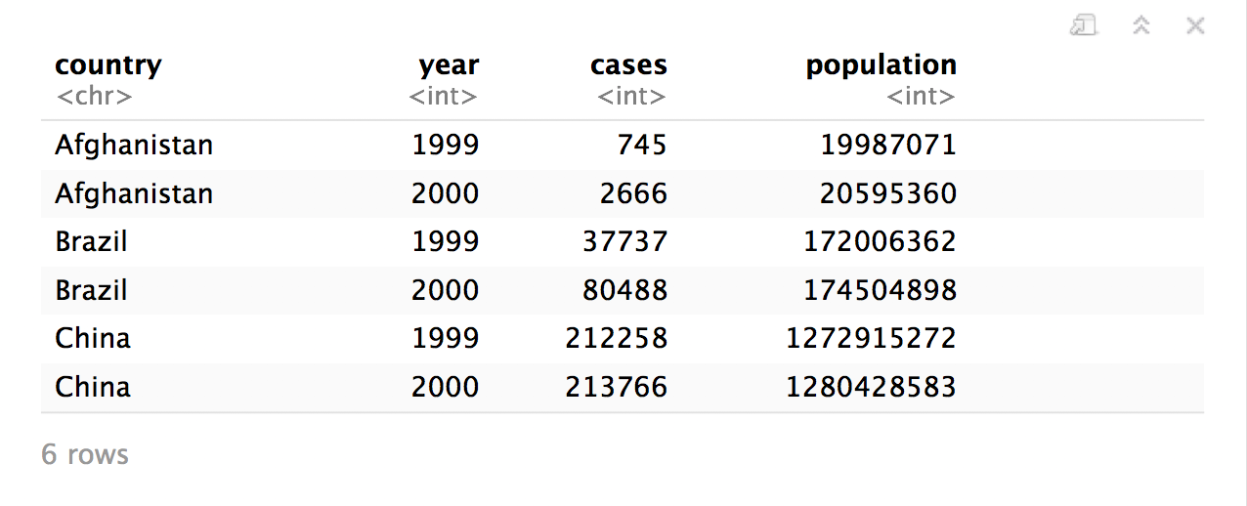
Recall
What are the variables in this data set?
table1

Slide 5
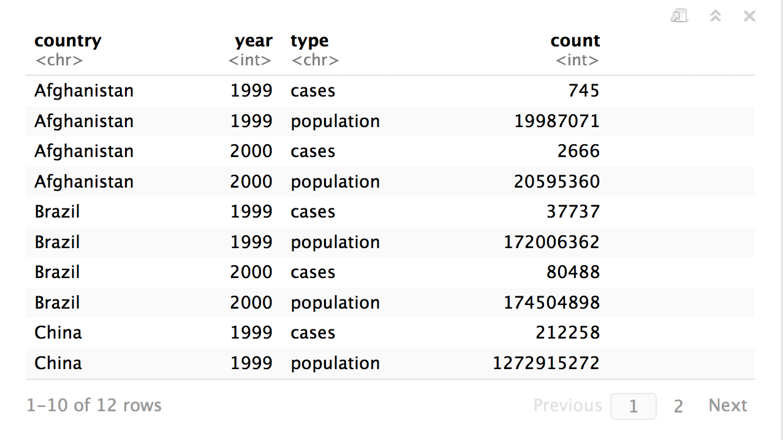
Recall
What are the variables in this data set?
table2

Slide 6
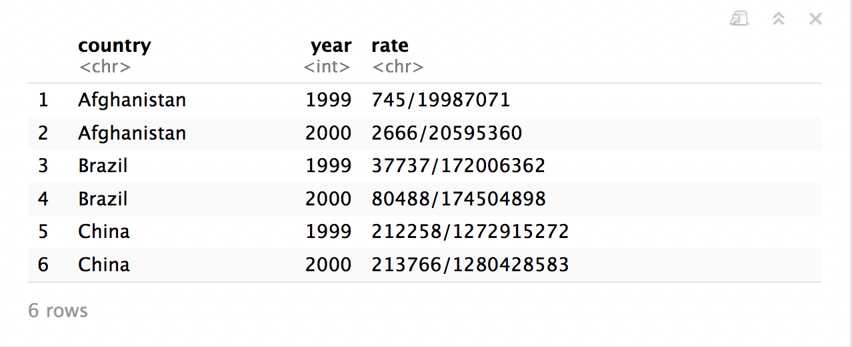
table3

Slide 7
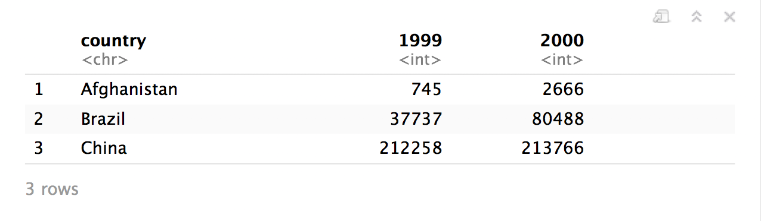
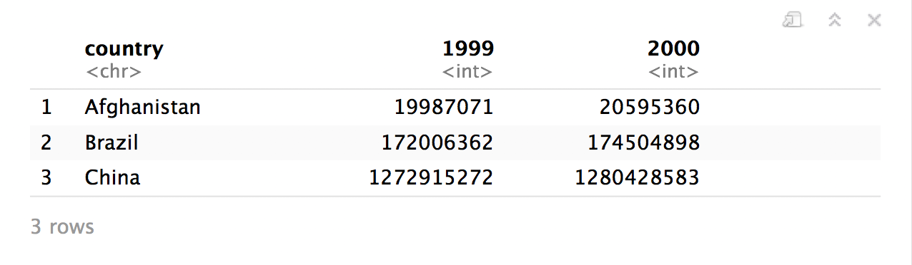
table4a
table4b

Slide 8
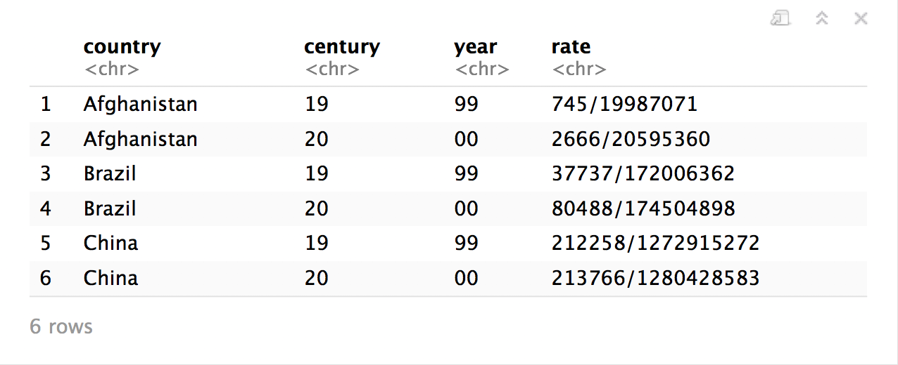
table5

Slide 9
table1$country
table1$year
table1$cases
table1$population

Slide 10


table2$country
table2$year
table2$count[c(1,3,5,7,9,11)]
table2$count[c(2,4,6,8,10,12)]

Slide 11
"Data comes in many formats, but R prefers just one: tidy data. "

Slide 12
Tidy data
country | year | cases | pop
Afghanistan | 1999 | 745 | 19987071
Afghanistan | 2000 | 2666 | 20595360
Brazil | 1999 | 37737 | 172006362
Brazil | 2000 | 80488 | 174504898
China | 1999 | 212258 | 1272915272
China | 2000 | 213766 | 1280428583
A data set is tidy iff:
Each variable is in its own column
Each case is in its own row
Each value is in its own cell

Slide 13
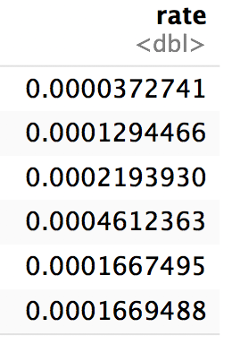
table1$cases / table1$population -> table1$rate

Slide 14
"Tidy data sets are all alike; but every messy data set is messy in its own way."
- Hadley Wickham

Slide 15

tidyr

Slide 16
tidyr
A package that reshapes the layout of tabular data.

Slide 17
gather()

Slide 18
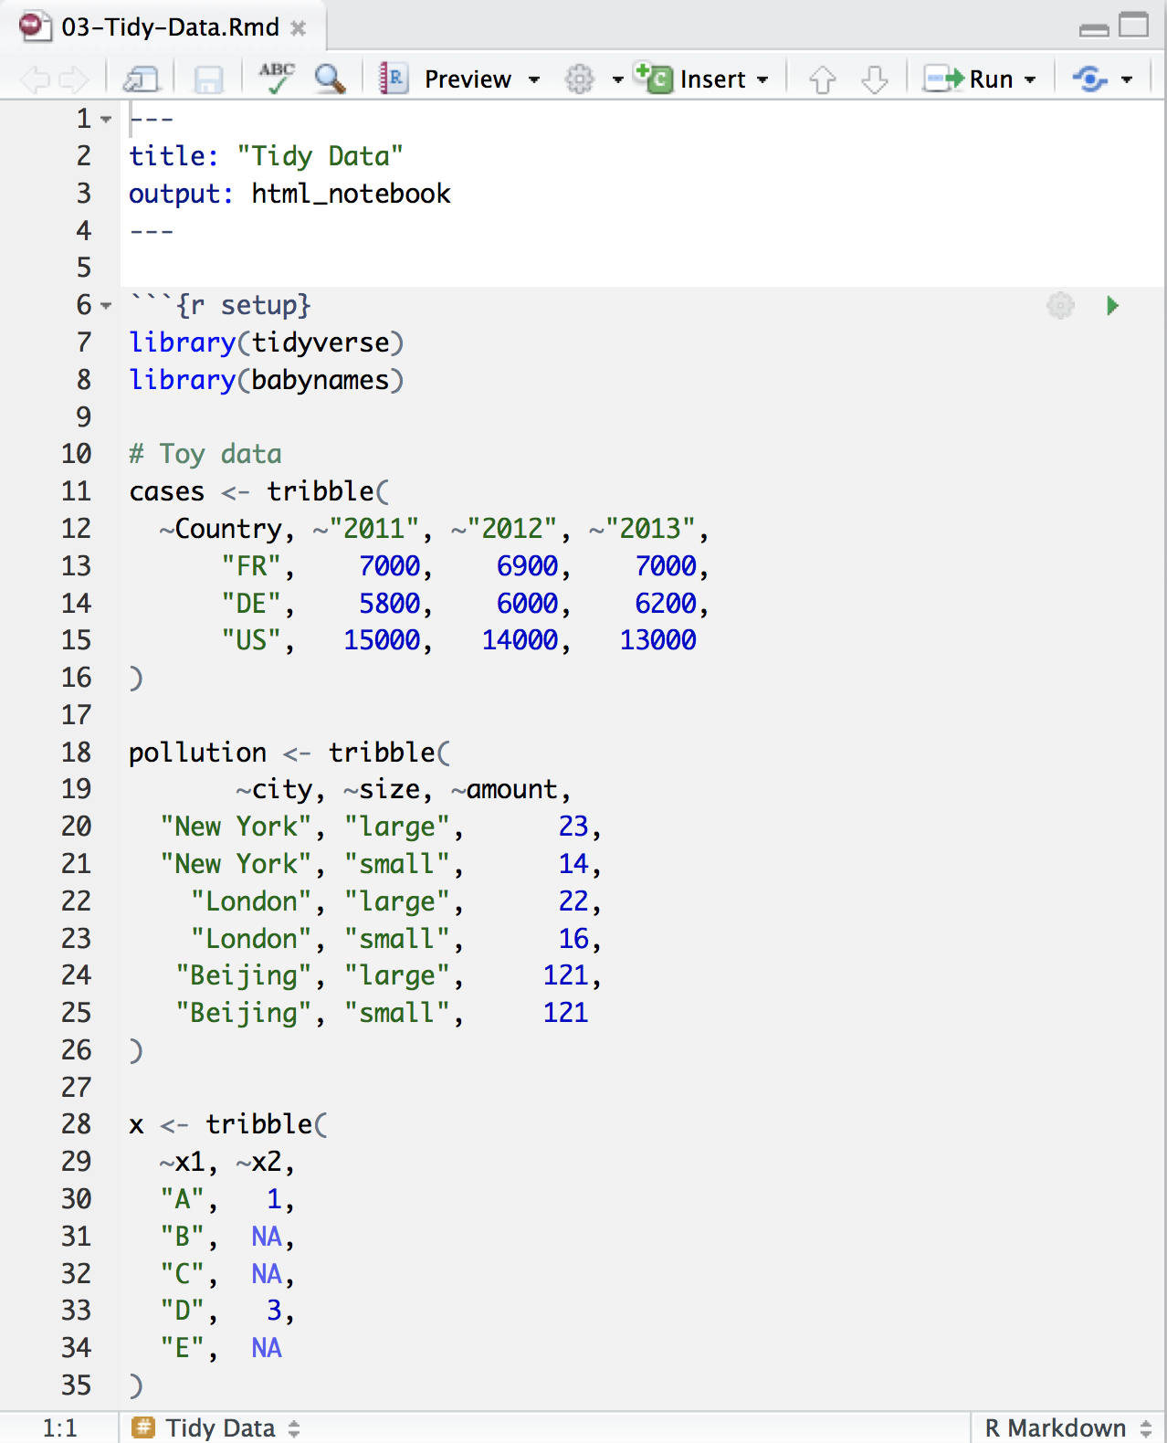
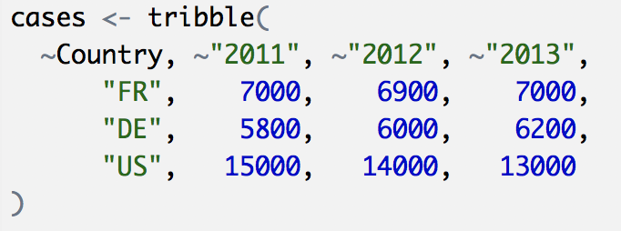
Toy data

Slide 19
Quiz
What are the variables in cases?
Country | 2011 | 2012 | 2013
FR | 7000 | 6900 | 7000
DE | 5800 | 6000 | 6200
US | 15000 | 14000 | 13000

Slide 20
Quiz
What are the variables in cases?
Country | 2011 | 2012 | 2013
FR | 7000 | 6900 | 7000
DE | 5800 | 6000 | 6200
US | 15000 | 14000 | 13000
Country
Year
Count

Slide 21
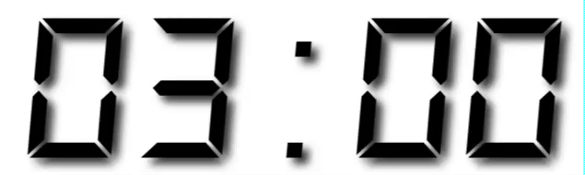
Your Turn 1
On a sheet of paper, draw how the cases data set would look if it had the same values grouped into three columns: country, year, n
Country | 2011 | 2012 | 2013
FR | 7000 | 6900 | 7000
DE | 5800 | 6000 | 6200
US | 15000 | 14000 | 13000

Slide 22
Country | 2011 | 2012 | 2013
FR | 7000 | 6900 | 7000
DE | 5800 | 6000 | 6200
US | 15000 | 14000 | 13000

Slide 23
Country | 2011 | 2012 | 2013
FR | 7000 | 6900 | 7000
DE | 5800 | 6000 | 6200
US | 15000 | 14000 | 13000
Country | Year | n
FR | 2011 | 7000
DE | 2011 | 5800
US | 2011 | 15000
FR | 2012 | 6900
DE | 2012 | 6000
US | 2012 | 14000
FR | 2013 | 7000
DE | 2013 | 6200
US | 2013 | 13000

Slide 24
Country | 2011 | 2012 | 2013
FR | 7000 | 6900 | 7000
DE | 5800 | 6000 | 6200
US | 15000 | 14000 | 13000
Country | Year | n
FR | 2011 | 7000
DE | 2011 | 5800
US | 2011 | 15000
FR | 2012 | 6900
DE | 2012 | 6000
US | 2012 | 14000
FR | 2013 | 7000
DE | 2013 | 6200
US | 2013 | 13000

Slide 25
Country | 2011 | 2012 | 2013
FR | 7000 | 6900 | 7000
DE | 5800 | 6000 | 6200
US | 15000 | 14000 | 13000
Country | Year | n
FR | 2011 | 7000
DE | 2011 | 5800
US | 2011 | 15000
FR | 2012 | 6900
DE | 2012 | 6000
US | 2012 | 14000
FR | 2013 | 7000
DE | 2013 | 6200
US | 2013 | 13000

Slide 26
Country | 2011 | 2012 | 2013
FR | 7000 | 6900 | 7000
DE | 5800 | 6000 | 6200
US | 15000 | 14000 | 13000
Country | Year | n
FR | 2011 | 7000
DE | 2011 | 5800
US | 2011 | 15000
FR | 2012 | 6900
DE | 2012 | 6000
US | 2012 | 14000
FR | 2013 | 7000
DE | 2013 | 6200
US | 2013 | 13000

Slide 27
Country | 2011 | 2012 | 2013
FR | 7000 | 6900 | 7000
DE | 5800 | 6000 | 6200
US | 15000 | 14000 | 13000
Country | Year | n
FR | 2011 | 7000
DE | 2011 | 5800
US | 2011 | 15000
FR | 2012 | 6900
DE | 2012 | 6000
US | 2012 | 14000
FR | 2013 | 7000
DE | 2013 | 6200
US | 2013 | 13000

Slide 28
Country | 2011 | 2012 | 2013
FR | 7000 | 6900 | 7000
DE | 5800 | 6000 | 6200
US | 15000 | 14000 | 13000
Country | Year | n
FR | 2011 | 7000
DE | 2011 | 5800
US | 2011 | 15000
FR | 2012 | 6900
DE | 2012 | 6000
US | 2012 | 14000
FR | 2013 | 7000
DE | 2013 | 6200
US | 2013 | 13000

Slide 29
Country | 2011 | 2012 | 2013
FR | 7000 | 6900 | 7000
DE | 5800 | 6000 | 6200
US | 15000 | 14000 | 13000
Country | Year | n
FR | 2011 | 7000
DE | 2011 | 5800
US | 2011 | 15000
FR | 2012 | 6900
DE | 2012 | 6000
US | 2012 | 14000
FR | 2013 | 7000
DE | 2013 | 6200
US | 2013 | 13000

Slide 30
Country | 2011 | 2012 | 2013
FR | 7000 | 6900 | 7000
DE | 5800 | 6000 | 6200
US | 15000 | 14000 | 13000
Country | Year | n
FR | 2011 | 7000
DE | 2011 | 5800
US | 2011 | 15000
FR | 2012 | 6900
DE | 2012 | 6000
US | 2012 | 14000
FR | 2013 | 7000
DE | 2013 | 6200
US | 2013 | 13000

Slide 31
Country | 2011 | 2012 | 2013
FR | 7000 | 6900 | 7000
DE | 5800 | 6000 | 6200
US | 15000 | 14000 | 13000
Country | Year | n
FR | 2011 | 7000
DE | 2011 | 5800
US | 2011 | 15000
FR | 2012 | 6900
DE | 2012 | 6000
US | 2012 | 14000
FR | 2013 | 7000
DE | 2013 | 6200
US | 2013 | 13000

Slide 32
Country | 2011 | 2012 | 2013
FR | 7000 | 6900 | 7000
DE | 5800 | 6000 | 6200
US | 15000 | 14000 | 13000
Country | Year | n
FR | 2011 | 7000
DE | 2011 | 5800
US | 2011 | 15000
FR | 2012 | 6900
DE | 2012 | 6000
US | 2012 | 14000
FR | 2013 | 7000
DE | 2013 | 6200
US | 2013 | 13000

Slide 33
Country | 2011 | 2012 | 2013
FR | 7000 | 6900 | 7000
DE | 5800 | 6000 | 6200
US | 15000 | 14000 | 13000
Country | Year | n
FR | 2011 | 7000
DE | 2011 | 5800
US | 2011 | 15000
FR | 2012 | 6900
DE | 2012 | 6000
US | 2012 | 14000
FR | 2013 | 7000
DE | 2013 | 6200
US | 2013 | 13000

Slide 34
Country | 2011 | 2012 | 2013
FR | 7000 | 6900 | 7000
DE | 5800 | 6000 | 6200
US | 15000 | 14000 | 13000
Country | Year | n
FR | 2011 | 7000
DE | 2011 | 5800
US | 2011 | 15000
FR | 2012 | 6900
DE | 2012 | 6000
US | 2012 | 14000
FR | 2013 | 7000
DE | 2013 | 6200
US | 2013 | 13000
gather()

Slide 35
1
2
Country | 2011 | 2012 | 2013
FR | 7000 | 6900 | 7000
DE | 5800 | 6000 | 6200
US | 15000 | 14000 | 13000
Country | Year | n
FR | 2011 | 7000
DE | 2011 | 5800
US | 2011 | 15000
FR | 2012 | 6900
DE | 2012 | 6000
US | 2012 | 14000
FR | 2013 | 7000
DE | 2013 | 6200
US | 2013 | 13000

Slide 36
key (former column names)
Country | 2011 | 2012 | 2013
FR | 7000 | 6900 | 7000
DE | 5800 | 6000 | 6200
US | 15000 | 14000 | 13000
Country | Year | n
FR | 2011 | 7000
DE | 2011 | 5800
US | 2011 | 15000
FR | 2012 | 6900
DE | 2012 | 6000
US | 2012 | 14000
FR | 2013 | 7000
DE | 2013 | 6200
US | 2013 | 13000

Slide 37
key
value (former cells)
Country | 2011 | 2012 | 2013
FR | 7000 | 6900 | 7000
DE | 5800 | 6000 | 6200
US | 15000 | 14000 | 13000
Country | Year | n
FR | 2011 | 7000
DE | 2011 | 5800
US | 2011 | 15000
FR | 2012 | 6900
DE | 2012 | 6000
US | 2012 | 14000
FR | 2013 | 7000
DE | 2013 | 6200
US | 2013 | 13000

Slide 38
gather()
cases %>% gather(key = "year", value = "n", 2:4)
data frame to reshape
name of the new key column
(a character string)
name of the new value column
(a character string)
numeric indexes of columns to collapse
(or names)

Slide 39
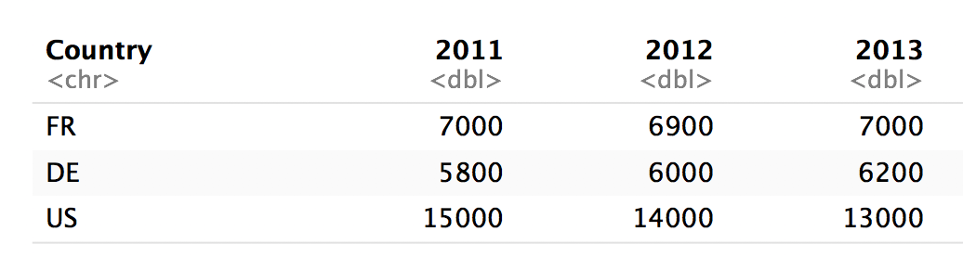
gather()
cases %>% gather("year","n", 2:4)
numeric indexes
2
3
4

Slide 40
gather()
cases %>% gather("year","n", "2011", "2012", "2013")
names
2011
2012
2013

Slide 41
gather()
cases %>% gather("year","n", -Country)
Everything except…
Not Country
Not Country
Not Country

Slide 42
gather()
cases %>% gather("year","n", 2:4)
cases %>% gather("year","n", "2011", "2012", "2013")
cases %>% gather("year","n", starts_with("201"))
cases %>% gather("year","n", -Country)

Slide 43
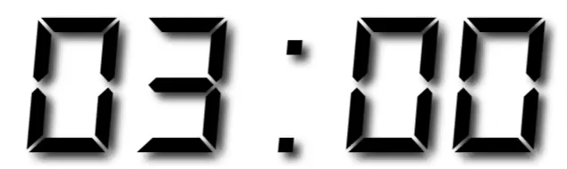
Your Turn 2
Use gather() to reorganize table4a into three columns: country, year, and cases.

Slide 44
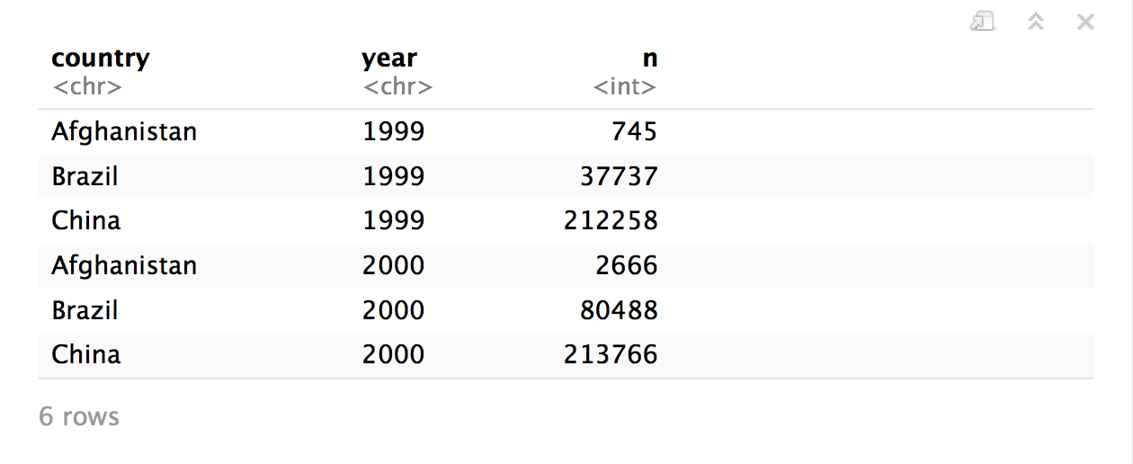
table4a %>%
gather(key = "year", value = "n", 2:3)

Slide 45
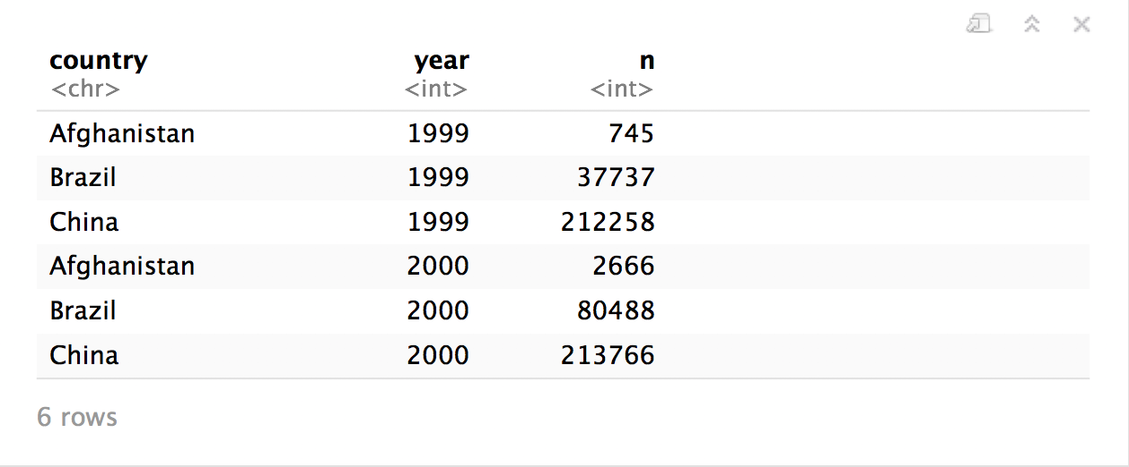
table4a %>%
gather(key = "year", value = "n", 2:3, convert = TRUE)

Slide 46
spread()

Slide 47
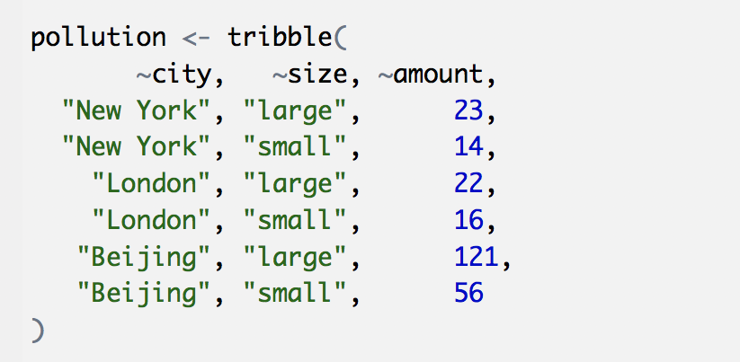
Toy data

Slide 48
Quiz
What are the variables in pollution?
city | particle size | amount (µg/m³)
New York | large | 23
New York | small | 14
London | large | 22
London | small | 16
Beijing | large | 121
Beijing | small | 56

Slide 49

Quiz
What are the variables in pollution?
city | particle size | amount (µg/m³)
New York | large | 23
New York | small | 14
London | large | 22
London | small | 16
Beijing | large | 121
Beijing | small | 56
City
Amount of large particulate
Amount of small particulate

Slide 50
Your Turn 3
On a sheet of paper, draw how this data set would look if it had the same values grouped into three columns: city, large, small
city | size | amount
New York | large | 23
New York | small | 14
London | large | 22
London | small | 16
Beijing | large | 121
Beijing | small | 56

Slide 51
city | size | amount
New York | large | 23
New York | small | 14
London | large | 22
London | small | 16
Beijing | large | 121
Beijing | small | 56

Slide 52
city | size | amount
New York | large | 23
New York | small | 14
London | large | 22
London | small | 16
Beijing | large | 121
Beijing | small | 56
city | large | small
New York | 23 | 14
London | 22 | 16
Beijing | 121 | 56

Slide 53
city | size | amount
New York | large | 23
New York | small | 14
London | large | 22
London | small | 16
Beijing | large | 121
Beijing | small | 56
city | large | small
New York | 23 | 14
London | 22 | 16
Beijing | 121 | 56

Slide 54
city | size | amount
New York | large | 23
New York | small | 14
London | large | 22
London | small | 16
Beijing | large | 121
Beijing | small | 56
city | large | small
New York | 23 | 14
London | 22 | 16
Beijing | 121 | 56

Slide 55
city | size | amount
New York | large | 23
New York | small | 14
London | large | 22
London | small | 16
Beijing | large | 121
Beijing | small | 56
city | large | small
New York | 23 | 14
London | 22 | 16
Beijing | 121 | 56

Slide 56
city | size | amount
New York | large | 23
New York | small | 14
London | large | 22
London | small | 16
Beijing | large | 121
Beijing | small | 56
city | large | small
New York | 23 | 14
London | 22 | 16
Beijing | 121 | 56

Slide 57
city | size | amount
New York | large | 23
New York | small | 14
London | large | 22
London | small | 16
Beijing | large | 121
Beijing | small | 56
city | large | small
New York | 23 | 14
London | 22 | 16
Beijing | 121 | 56

Slide 58
city | size | amount
New York | large | 23
New York | small | 14
London | large | 22
London | small | 16
Beijing | large | 121
Beijing | small | 56
city | large | small
New York | 23 | 14
London | 22 | 16
Beijing | 121 | 56

Slide 59
city | size | amount
New York | large | 23
New York | small | 14
London | large | 22
London | small | 16
Beijing | large | 121
Beijing | small | 56
city | large | small
New York | 23 | 14
London | 22 | 16
Beijing | 121 | 56

Slide 60
city | size | amount
New York | large | 23
New York | small | 14
London | large | 22
London | small | 16
Beijing | large | 121
Beijing | small | 56
spread()
city | large | small
New York | 23 | 14
London | 22 | 16
Beijing | 121 | 56

Slide 61
1
2
city | size | amount
New York | large | 23
New York | small | 14
London | large | 22
London | small | 16
Beijing | large | 121
Beijing | small | 56
city | large | small
New York | 23 | 14
London | 22 | 16
Beijing | 121 | 56

Slide 62
key (new column names)
city | size | amount
New York | large | 23
New York | small | 14
London | large | 22
London | small | 16
Beijing | large | 121
Beijing | small | 56
city | large | small
New York | 23 | 14
London | 22 | 16
Beijing | 121 | 56

Slide 63
key
value (new cells)
city | size | amount
New York | large | 23
New York | small | 14
London | large | 22
London | small | 16
Beijing | large | 121
Beijing | small | 56
city | large | small
New York | 23 | 14
London | 22 | 16
Beijing | 121 | 56

Slide 64
spread()
pollution %>% spread(key = size, value = amount)
data frame to reshape
column to use for keys (becomes new
column names)
column to use for values
(becomes new
column cells)

Slide 65
pollution %>% spread(size, amount)
city size amount
1 New York large 23
2 New York small 14
3 London large 22
4 London small 16
5 Beijing large 121
6 Beijing small 56
city large small
1 Beijing 121 56
2 London 22 16
3 New York 23 14

Slide 66
Your Turn 4
Use spread() to reorganize table2 into four columns: country, year, cases, and population.

Slide 67
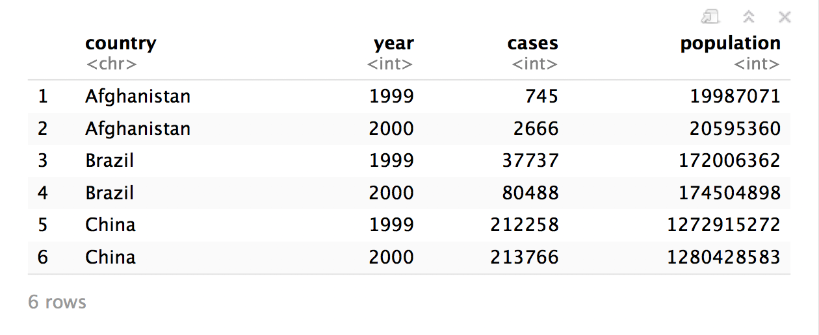
table2 %>%
spread(key = type, value = count)

Slide 68
who
(Untidy Data)

Slide 69
# In exercises.Rmd
# To avoid a distracting detail during class
names(who) <- stringr::str_replace(names(who),
"newrel",
"new_rel")

Slide 70
who
Tuberculosis (TB) cases broken down by year, country, age, gender, and diagnosis method from the 2014 World Health Organization Global Tuberculosis Report
View(who)

Slide 71
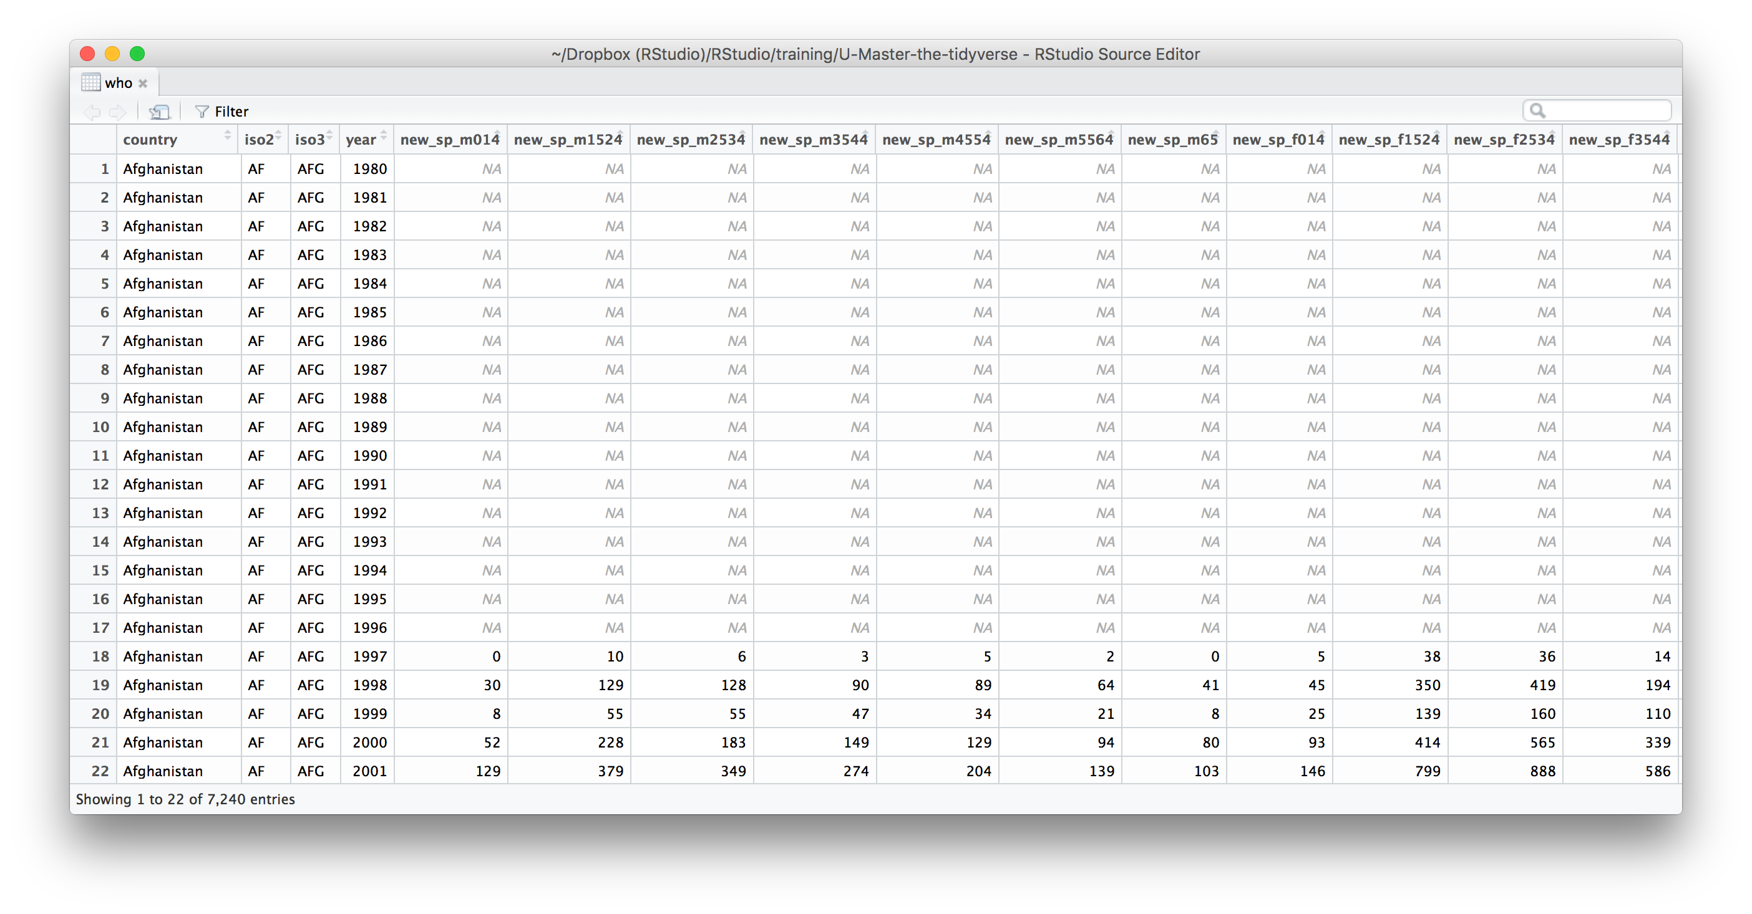
What variables does this data set contain?

Slide 72
who variables
country, iso2, iso3 - country identifiers
year - year
other columns names - encode type of TB case, sex, and age

Slide 73
who codes
Type of TB case
rel - relapse
ep - extra-pulmonary
sn- pulmonary, smear negative
sp -pulmonary, smear positive
Gender
m - male
f - female
Age group
014 - 0 to 14 years old
1524 - 15 to 24 years old
2534 - 25 to 34 years old
3544 - 35 to 44 years old
4554 - 45 to 54 years old
5564 - 55 to 64 years old
65 - 65 and older

Slide 75
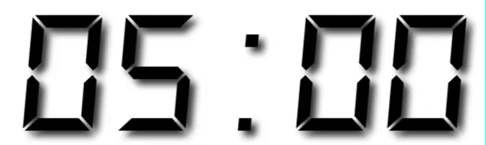
Your Turn 5
Gather the 5th through 60th columns of who into a pair of key:value columns named codes and n.
Then select just the country, year, codes and n variables.

Slide 76
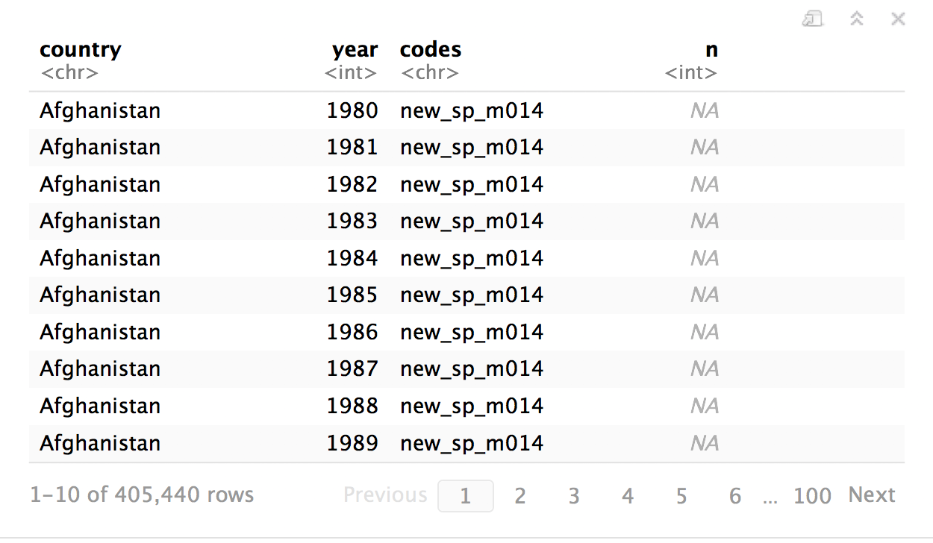
who %>%
gather(key = "codes", value = "n", 5:60) %>%
select(-iso2, -iso3)

Slide 77
separate()

Slide 78
separate()
Splits a column by dividing values at a specific character.
who %>%
gather("codes", "n", 5:60) %>%
select(-iso2, -iso3) %>%
separate(codes, into = c("new", "type", "sexage"), sep = "_")
a column to split
names of new columns to make
string to split on
(Defaults to any non_alpha-numeric character)

Slide 79
separate(storms, date, c("year","month","day"), sep = "-")
storm wind pressure date
1 Alberto 110 1007 2000-08-03
2 Alex 45 1009 1998-07-27
3 Allison 65 1005 1995-06-03
4 Ana 40 1013 1997-06-30
5 Arlene 50 1010 1999-06-11
6 Arthur 45 1010 1996-06-17
storm wind pressure year month day
1 Alberto 110 1007 2000 08 03
2 Alex 45 1009 1998 07 27
3 Allison 65 1005 1995 06 03
4 Ana 40 1013 1997 06 30
5 Arlene 50 1010 1999 06 11
6 Arthur 45 1010 1996 06 17

Slide 80
separate(storms, date, c("year","month","day"), sep = "-")
storm wind pressure date
1 Alberto 110 1007 2000-08-03
2 Alex 45 1009 1998-07-27
3 Allison 65 1005 1995-06-03
4 Ana 40 1013 1997-06-30
5 Arlene 50 1010 1999-06-11
6 Arthur 45 1010 1996-06-17
storm wind pressure year month day
1 Alberto 110 1007 "2000" "08" "03"
2 Alex 45 1009 "1998" "07" "27"
3 Allison 65 1005 "1995" "06" "03"
4 Ana 40 1013 "1997" "06" "30"
5 Arlene 50 1010 "1999" "06" "11"
6 Arthur 45 1010 "1996" "06" "17"

Slide 81
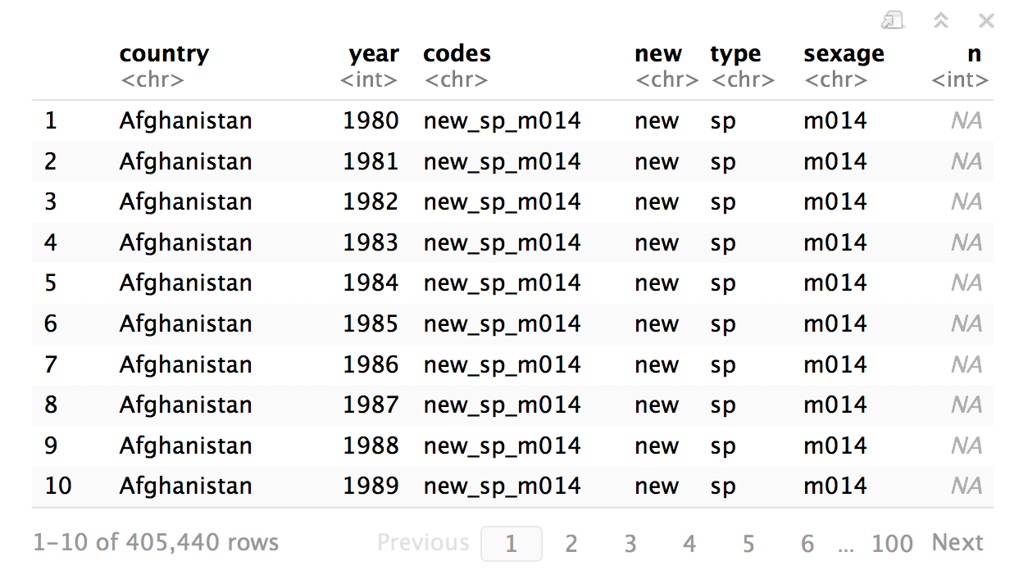
who %>%
gather("codes", "n", 5:60) %>%
select(-iso2, -iso3) %>%
separate(
)

Slide 82
who %>%
gather("codes", "n", 5:60) %>%
select(-iso2, -iso3) %>%
separate(codes
)

Slide 83
who %>%
gather("codes", "n", 5:60) %>%
select(-iso2, -iso3) %>%
separate(codes, into = c("new", "type", "sexage")
)

Slide 84
who %>%
gather("codes", "n", 5:60) %>%
select(-iso2, -iso3) %>%
separate(codes, into = c("new", "type", "sexage"), sep = "_")
)

Slide 85
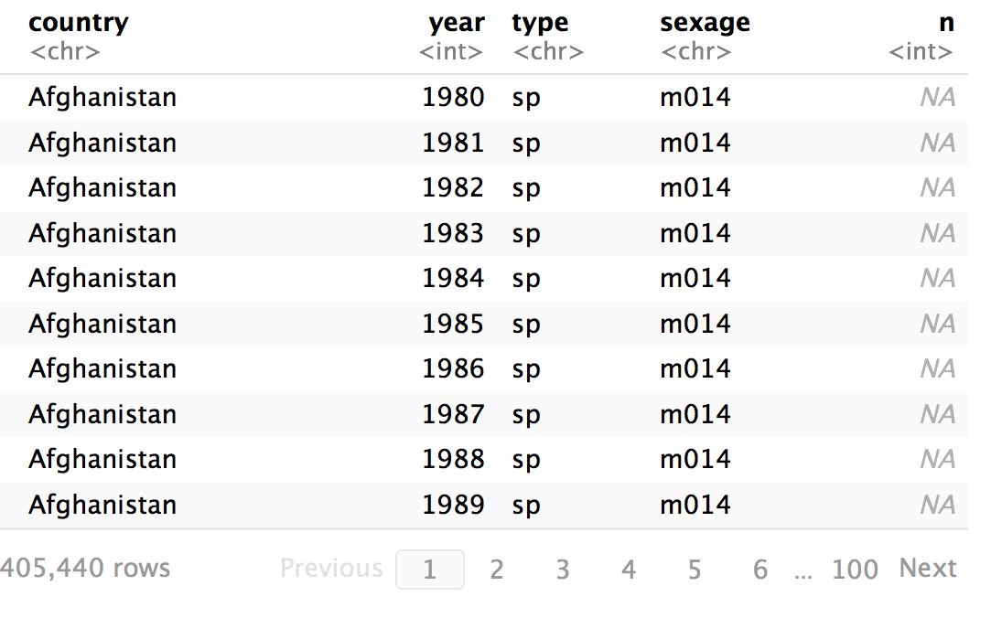
who %>%
gather("codes", "n", 5:60) %>%
select(-iso2, -iso3) %>%
separate(codes, c("new", "type", "sexage"), sep = "_") %>%
select(-new)

Slide 86
separate()
Splits a column by dividing values at a specific character.
who %>%
gather("codes", "n", 5:60) %>%
select(-iso2, -iso3) %>%
separate(codes, c("new", "type", "sexage"), sep = c(4, 7))
locations to split at
(Split after 4th and 7th characters)

Slide 87
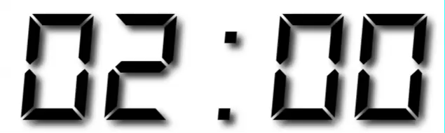
Your Turn 6
Separate the sexage column into sex and age columns.

Slide 88
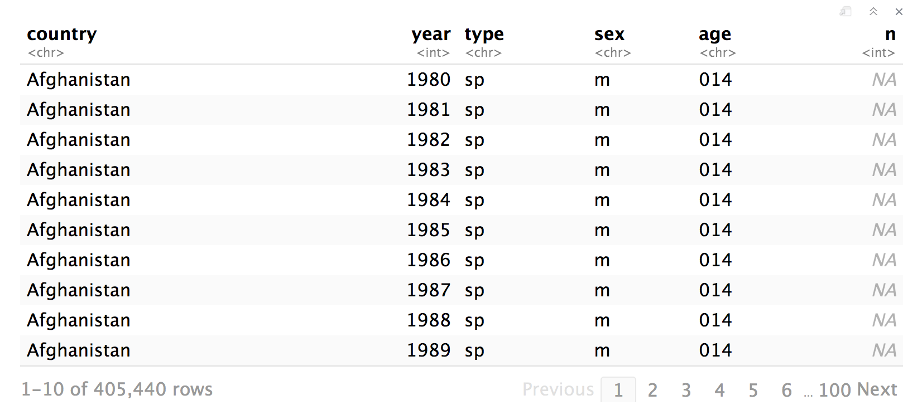
who %>%
gather("codes", "n", 5:60) %>%
select(-iso2, -iso3) %>%
separate(codes, c("new", "type", "sexage"), sep = "_") %>%
select(-new) %>%
separate(sexage, into = c("sex", "age"), sep = 1)

Slide 89
unite()

Slide 90
unite()
Unites columns into single column by combining cells.
unite(data, col, …, sep = "")
data frame to reshape
name of new column to make
(in quotes)
two or more columns to combine
separator to place between elements in new column
(Defaults to an underscore)

Slide 91
who %>%
gather("codes", "n", 5:60) %>%
select(-iso2, -iso3) %>%
separate(codes, c("new", "type", "sexage"), sep = "_") %>%
select(-new) %>%
separate(sexage, into = c("sex", "age"), sep = 1) %>%
unite(

Slide 92
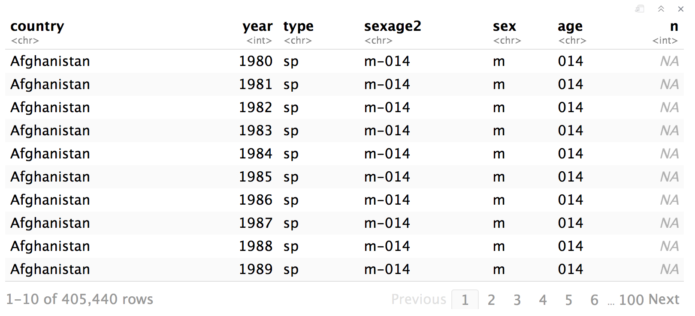
who %>%
gather("codes", "n", 5:60) %>%
select(-iso2, -iso3) %>%
separate(codes, c("new", "type", "sexage"), sep = "_") %>%
select(-new) %>%
separate(sexage, into = c("sex", "age"), sep = 1) %>%
unite("sexage2"

Slide 93
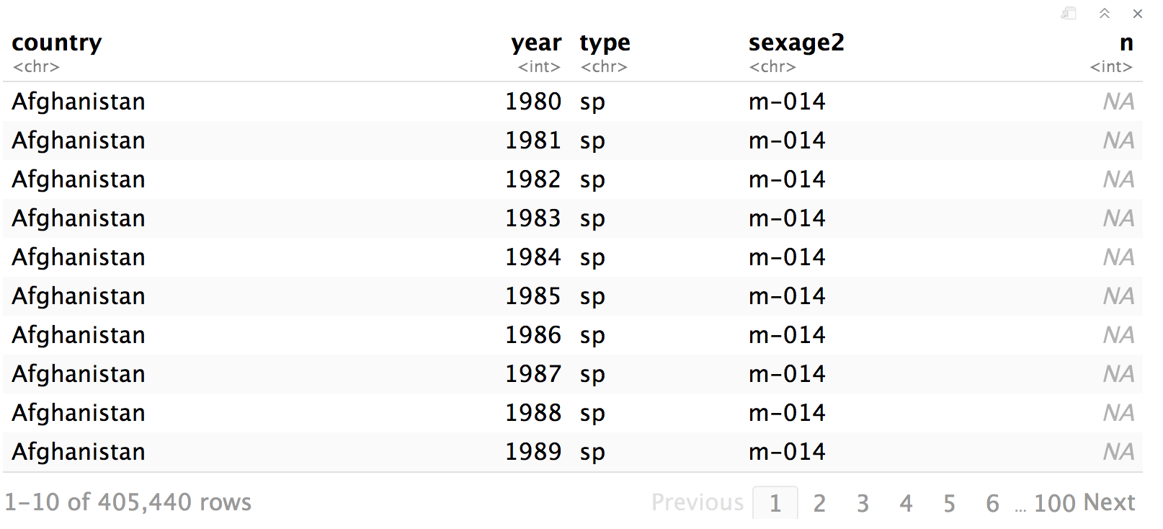
who %>%
gather("codes", "n", 5:60) %>%
select(-iso2, -iso3) %>%
separate(codes, c("new", "type", "sexage"), sep = "_") %>%
select(-new) %>%
separate(sexage, into = c("sex", "age"), sep = 1) %>%
unite("sexage2", sex, age

Slide 94
who %>%
gather("codes", "n", 5:60) %>%
select(-iso2, -iso3) %>%
separate(codes, c("new", "type", "sexage"), sep = "_") %>%
select(-new) %>%
separate(sexage, into = c("sex", "age"), sep = 1) %>%
unite("sexage2", sex, age, sep = "-"

Slide 95
who %>%
gather("codes", "n", 5:60) %>%
select(-iso2, -iso3) %>%
separate(codes, c("new", "type", "sexage"), sep = "_") %>%
select(-new) %>%
separate(sexage, into = c("sex", "age"), sep = 1) %>%
unite("sexage2", sex, age, sep = "-")

Slide 96
Missing
Values

Slide 97
filter(!is.na())
Drops rows that contain NA’s in the specified columns.
x %>% filter(!is.na(x2))
x
x
x1 | x2
A | 1
B | NA
C | NA
D | 3
E | NA
x1 | x2
A | 1
D | 3

Slide 98
drop_na()
Drops rows that contain NA’s in the specified columns.
x %>% drop_na(x2)
x
x
x1 | x2
A | 1
B | NA
C | NA
D | 3
E | NA
x1 | x2
A | 1
D | 3

Slide 99
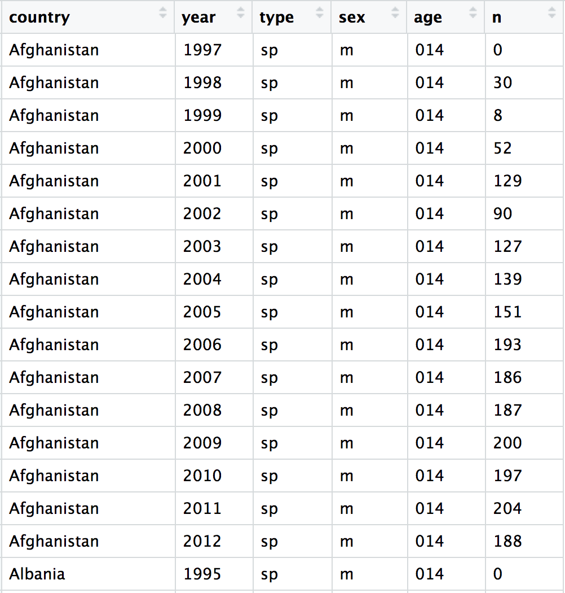
who %>%
gather("codes", "n", 5:60) %>%
separate(codes, c("new", "type", "sexage"), sep = "_") %>%
select(-new, -iso2, -iso3) %>%
separate(sexage, c("sex", "age"), sep = 1) %>%
drop_na(n)

Slide 100
Recap
 | wind | wind
 | pressure | 1009
 | pressure | 1009
 | Allison | 1005
 | Allison | 1013
 | Arlene | 1010
 | Arthur | 1010
 | pressure
 | 1007
 | 1009
Move values into column names with spread()
 | pressure
 | 1007
 | 1009
 | wind | wind
 | pressure | 1009
 | pressure | 1009
 | Allison | 1005
 | Allison | 1013
 | Arlene | 1010
 | Arthur | 1010
Move column names into values with gather()
Split a column with separate() or separate_rows()
wind
1005
1005
1005
1005
1005
1005
wind
1005
1005
1005
1005
1005
1005
wind
1005
1005
1005
1005
1005
1005
wind
1005
1005
1005
1005
1005
1005
wind
1005
1005
1005
1005
1005
1005
wind
1005
1005
1005
1005
1005
1005
wind
1005
1005
1005
1005
1005
1005
wind
1005
1005
1005
1005
1005
1005
Unite columns with unite()

Slide 101
Reshaping
Final Exam

Slide 102
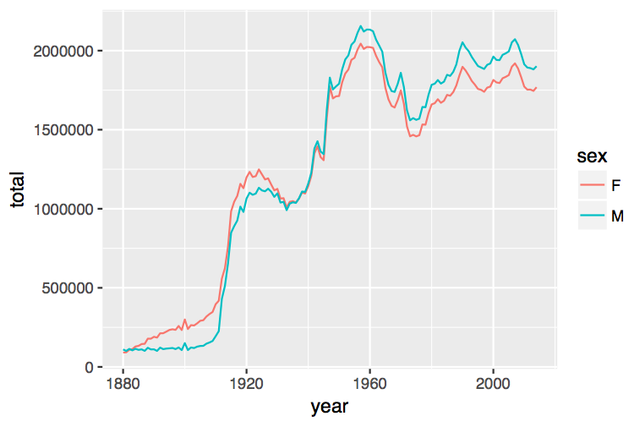
Number of children by year and gender
Let's plot % male
(or female)

Slide 103
Can we calculate the yearly percent of boys (or girls)?
babynames
year sex name n prop
<dbl> <chr> <chr> <int> <dbl>
1 1880 F Mary 7065 0.0724
2 1880 F Anna 2604 0.0267
3 1880 F Emma 2003 0.0205
4 1880 F Elizabeth 1939 0.0199
5 1880 F Minnie 1746 0.0179
6 1880 F Margaret 1578 0.0162
7 1880 F Ida 1472 0.0151
8 1880 F Alice 1414 0.0145
9 1880 F Bertha 1320 0.0135
10 1880 F Sarah 1288 0.0132

Slide 104
Can we calculate the yearly percent of boys (or girls)?
babynames %>%
group_by(year, sex) %>%
summarise(n = sum(n))
year sex n
<dbl> <chr> <int>
1 1880 F 90993
2 1880 M 110491
3 1881 F 91954
4 1881 M 100745
5 1882 F 107850
6 1882 M 113688
7 1883 F 112321
8 1883 M 104629
9 1884 F 129022
10 1884 M 114445
# ... with 260 more rows

Slide 105
Can we calculate the yearly percent of boys (or girls)?
babynames %>%
group_by(year, sex) %>%
summarise(n = sum(n))
year sex n
<dbl> <chr> <int>
1 1880 F 90993
2 1880 M 110491
3 1881 F 91954
4 1881 M 100745
5 1882 F 107850
6 1882 M 113688
7 1883 F 112321
8 1883 M 104629
9 1884 F 129022
10 1884 M 114445
# ... with 260 more rows
$$\%male=\frac{male}{male+female}×100$$
Now what?

Slide 106
Can we calculate the yearly percent of boys (or girls)?
better_layout %>%
mutate(percent_male = M / (M + F) * 100)
year sex n
<dbl> <chr> <int>
1 1880 F 90993
2 1880 M 110491
3 1881 F 91954
4 1881 M 100745
5 1882 F 107850
6 1882 M 113688
7 1883 F 112321
8 1883 M 104629
9 1884 F 129022
10 1884 M 114445
# ... with 260 more rows
year F M
* <dbl> <int> <int>
1 1880 90993 110491
2 1881 91954 100745
3 1882 107850 113688
4 1883 112321 104629
5 1884 129022 114445
6 1885 133055 107800
7 1886 144535 110784
8 1887 145982 101414
9 1888 178627 120853
10 1889 178366 110584
?

Slide 107
Your Turn 7
Extend this code to reshape the data. Calculate the percent of male (or female) children by year. Then plot the percent over time.
babynames %>%
group_by(year, sex) %>%
summarise(n = sum(n))
year sex n
<dbl> <chr> <int>
1 1880 F 90993
2 1880 M 110491
3 1881 F 91954
4 1881 M 100745
5 1882 F 107850
6 1882 M 113688
7 1883 F 112321
8 1883 M 104629
9 1884 F 129022
10 1884 M 114445
# ... with 260 more rows
year F M
* <dbl> <int> <int>
1 1880 90993 110491
2 1881 91954 100745
3 1882 107850 113688
4 1883 112321 104629
5 1884 129022 114445
6 1885 133055 107800
7 1886 144535 110784
8 1887 145982 101414
9 1888 178627 120853
10 1889 178366 110584
?

Slide 108
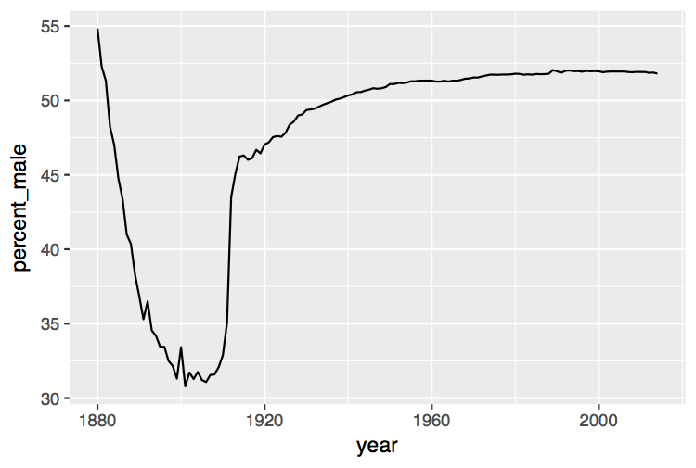
babynames %>%
group_by(year, sex) %>%
summarise(n = sum(n)) %>%
spread(sex, n) %>%
mutate(percent_male = M / (M + F) * 100) %>%
ggplot(aes(year, percent_male)) + geom_line()

Slide 109
Percent of children that are male by year

Slide 110
General advice
Describe what you want to do in an equation. Each variable in the equation should correspond to a column in your data:
"color by sex"
color = sex
"calculate the proportion of males"
prop male = number of males / number of females + number of males

Slide 111
Tidy Data with

